Slide 1

HANDS-ON WITH REACT

Slide 2
In order to respond to user interactions like clicking, hovering, and focusing, you’ll need to add event handlers to your elements.
This is an extension of the learning completed in the JavaScript content and can be used extensively in JSX
Handling
events
Notes:
This is a simple extension of events in vanilla JavaScript. We will focus on onClick and buttons for the purposes of these projects

Slide 3
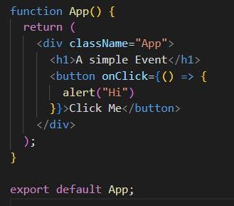
These function identically in JS, but remember, in react any pure JavaScript must be put in curly braces. E.g.
The anonymous function stops automatic processing of the script
Handling
events

Slide 4
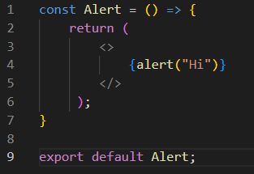
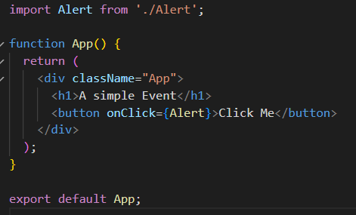
We tend to put the outcome of these events inside a component and import when needed
Handling
events

Slide 5
QuickLab 7
Event Handling

